Slide 1
Normalization

Slide 2
Normalization
process of organizing the data in the database to minimize the data duplication and update anomalies
Notes:
Anomalies: different from normal, deviation from common rule, type, arrangement. i.e update is not simple, updated value at one place and done is not u have to update at several places.

Slide 3
Definition
This is the process which allows to minimize redundant data within database.
This involves restructuring the tables to successively meeting higher forms of Normalization.
A properly normalized database should have the following characteristics
Scalar values in each fields
Absence of redundancy.
Minimal use of null values.
Minimal loss of information.
Notes:
Scalar value – simple single numeric value

Slide 4
Table
Roll No
Name
Mobile number
Email address
Department name
Department Location
Total Marks
Grade
CIE Marks

Slide 5
Null Values in Tuples
Relations should be designed such that their tuples will have as few NULL values as possible
Attributes that are NULL frequently could be placed in separate relations (with the primary key)
Reasons for nulls:
attribute not applicable or invalid
attribute value unknown (may exist)
value known to exist, but unavailable

Slide 6
Redundant Information in Tuples and Update Anomalies
Mixing attributes of multiple entities may cause problems
Information is stored redundantly wasting storage
Problems with update anomalies:
Insertion anomalies
Deletion anomalies
Modification anomalies

Slide 7
Anomalies
Insert Anomaly
Need to add marks while adding student if marks column is not null.
Update Anomaly
If want to change department location then needs to be changed in multiple records
Delete Anomaly
Deleting a department will result in deleting student information as well

Slide 8
Functional Dependencies
Functional Dependencies
We say an attribute, B, has a functional dependency on another attribute, A, if for any two records, which have
the same value for A, then the values for B in these two records must be the same. We illustrate this as:
A → B
Example: Suppose we keep track of student email addresses, and we only track one email address for each student. Suppose each student is identified by their unique roll number. We say there is a functional dependency of email address on roll number:
Roll number → email address

Slide 9
Determinant
Functional Dependency
roll number → Email address
Attribute on the LHS is known as the determinant
Roll Number is a determinant of Email address

Slide 10
Transitive dependency
Transitive dependency
Consider attributes A, B, and C, and where
A → B and B → C.
Functional dependencies are transitive, which means that we also have the functional dependency A → C
We say that C is transitively dependent on A through B.
Roll Number -> Total Marks
Total Marks -> Grades

Slide 11
Partial dependency
A partial dependency exists when an attribute B is functionally dependent on an attribute A, and A is a component of a multipart candidate key.
Candidate keys: {Roll Number, Department Number}
Department Location is partially dependent on {Roll Number, Department Number} as Department Number is a determinant of Department Location and Department Number is part of a candidate key

Slide 12
Levels of Normalization
Levels of normalization based on the amount of redundancy in the database.
Various levels of normalization are:
First Normal Form (1NF)
Second Normal Form (2NF)
Third Normal Form (3NF)
Boyce-Codd Normal Form (BCNF)
Fourth Normal Form (4NF)
Fifth Normal Form (5NF)
Domain Key Normal Form (DKNF)
Most databases should be 3NF or BCNF in order to avoid the database anomalies.

Slide 13
First Normal Form (1NF)
A table is considered to be in 1NF if all the fields contain
only scalar values (as opposed to list of values).
Example (Not 1NF)
ROllNo | Name | Mobile | Enmail | Department | Dept location | Total marks | Grade | CIE Marks
101 | ABC | 9898,2134,3214 | abc@gmail.com | COMP | Building B | 300 | A | 30,20,50
102 | PQR | 1234,5678,9087 | pqr@gmail.com | COMP | Building B | 290 | A | 40,30,50
103 | XYZ | 9999,8888 | xyz@gmail.com | Mech | Building C | 320 | A | 30,20,50
101 | ABC | 9898,2134,3214 | abc@gmail.com | MECH | Building C | 325 | A | 30,20,50
Mobile number and CIE marks columns are not scalar
Notes:
Having scalar values also means that all instances of a record type must contain the same number of fields.
A table not in first normal form is called un normalized

Slide 14
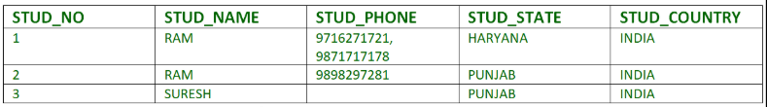
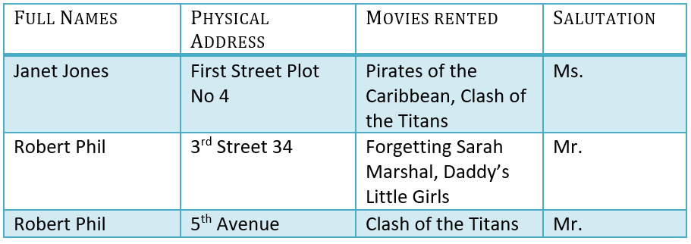

Slide 15

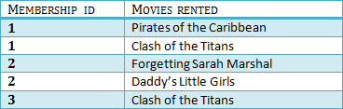

Slide 16
Second Normal Form (2NF)
For a table to be in 2NF, there are two requirements
The database is in first normal form
All nonkey attributes in the table must be functionally dependent on the entire primary key
No partial dependency
Note: Remember that we are dealing with non-key attributes
Example
Teacher Name, Subject Teaching, Tests Conducted, Reference Books
Key → {Teacher Name,Subject Teaching}
{Teacher Name,Subject Teaching} → {Tests Conducted}
{Subject Teaching} → {Reference Books}
Notes:
Student Name, Subject Name, Subject Marks, Subject Books
Key={Student Name, Subject Name}
Subject Marks are fully dependent on both the Keys
But Subject Books dependes on Subject Name not on student name so partially dependent on key.

Slide 17
Third Normal Form (3 NF)
For a table to be in 2NF, there are two requirements
It is in 2NF and
It contains no transitive dependencies.
Example
Key → {Roll No}
{Roll No} → {Total Marks}
{Total Marks} → {Grade}

Slide 18
Boyce-Codd Normal Form (BCNF)
Also called 3.5NF
3NF
For every FD LHS must be super key
all tables in the database should have only one primary key

Slide 19
Fourth Normal Form (4 NF)
For a table to be in 2NF, there are two requirements
It is in BCNF and
It should not have multi valued dependencies.
two attributes (or columns) in a table are independent of one another, but both depend on a third attribute
Example
Student Name, Course Name, Hobby (Here there is no relation between course name and hobby and both the attributes can have multiple values)

Slide 20
Example
Teacher Name | Subject | Age
ABC | Maths | 35
ABC | Science | 35
PQR | Physics | 39
LMN | Chemistry | 43
XYZ | History | 34
PQR | Chemistry | 39
Primary Key : Teacher Name, Subject
Not in 2nd normal form as age is partial dependent on primary key
To bring it in 2nd normal form, one table with (teacher name,age) , second table (teacher name, subject)

Slide 21
Example
SRN | Student Name | Course Code | Course Name | Course Duration | Course Result
201900001 | ABC | BTCHCS01 | Maths | 35 | A
201900001 | ABC | BTCHCS02 | Science | 35 | B
201900003 | PQR | BTCHCS03 | Physics | 45 | A+
201900004 | LMN | BTCHCS04 | Chemistry | 45 | B+
201900005 | XYZ | BTCHCS01 | Maths | 35 | A
Primary Key : SRN, Course Code
Not in 2nd normal form as student name, course name, course duration partial dependent on primary key
To bring it in 2nd normal form, one table with (SRN, Student Name) , second table (Course Code, Course Name, Course Duration) and third table (SRN, Course Code, Course Result)
Notes:
Course result is functionally fully dependant on both the keys result of this student for this subject

Slide 22
Example
Person Name | Age | Pin Code | City
ABC | 35 | 411 048 | Pune
ABC | 35 | 411 054 | Pune
PQR | 39 | 411 051 | Pune
LMN | 43 | 411 052 | Pune
XYZ | 34 | 411 053 | Pune
Primary Key : Name
Not in 3nd normal form as city is having transitive dependancy on pin
To bring it in 3nd normal form, one table with (name,age,pin) , second table (pin, city)
Primary Key : Name, Pin (If there are multiple people with same name but living at same location is difficult
Not in 2nd normal form as age and city partial dependent on primary key
To bring it in 3nd normal form, one table with (name, age) , second table (pin, city),third (name, pin)

Slide 23
Example
Person name
Person mobile number
Mobile model
Mobile memory
Mobile screen size
Mobile RAM
Mobile processor
Mobile number of SIMs
Mobile price

